Slide 1

Student JOB - Job Search Website
INSTRUCTORS:
THS.NGUYEN DO CONG PHAP
Our team:
dinh lam nghia 20IT5
Van cong truong tho 20it5

Slide 2


Slide 3
Student JOB - Job Search Website

Slide 5




Introduce
Languages ​​and tools
Demo
The reason why we choose this topic and what we did
Languages and tools that we used
Show our website

Slide 6



Why we choose
01
Along with the strong development of the Information Technology industry and the need to find jobs, especially new graduates. Building a job search website is necessary and reasonable
Introduce
The reason why we choose this topic and what we did
The result
Successfully built the website “Student JOB” to meet the simple business process of a job search website.

Slide 7


02
Tools ​​and languages
Languages and tools that we used
Visual Studio Code

Slide 8



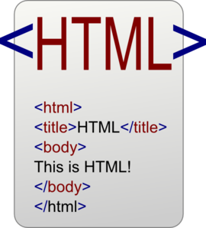

02
CSS 3
JAVASCRIPT
Tools ​​and languages
Languages and tools that we used
JQUERY
HTML 5
BOOTSTRAP

Slide 9

03
Demo
Show our website

Slide 10
Thanks for listening!

